Slide 1

IIIT NAGPUR

Slide 2

Fastest Fingers First using 555ic timer
By Bread-board, Tinkercad.
Notes:
NOTE:
To change the image on this slide, select the picture and delete it. Then click the Pictures icon in the placeholder to insert your own image.

Slide 3
GROUP MEMBERS
Sr no. | Name | Enrollment No.
1) | Chaitra Guruvelli | BT21ECE130
2) | Vanashree Parate | BT21ECE084
3) | Diksha Kamble | BT21ECE124

Slide 4
DRAFT
INTRODUCTION
COMPONENTS REQUIRED
CIRCUIT DIAGRAM
WORKING
ADVANTAGE
APPLICATIONS
REFERENCE

Slide 5
INTRODUCTION

Slide 6
INTRODUCTION
This mini project Fastest Fingers First can be used in quiz competitions and other group activities. Quiz-type game shows are increasingly becoming popular on television these days.
In such games, fastest finger first indicators (FFFIs) are used to test the player’s reaction time. The player’s designated number is displayed when the player presses his entry button. We can also include buzzer to get the audio.
The circuit presented here determines as to which of the three contestants first pressed the button and locks out the remaining two entries.

Slide 7
Components required

Slide 8
COMPONENTS REQUIRED
555 Timer IC
Resistors
Diodes
Breadboard
Momentary Pushbuttons
Connecting Wires
5V Battery
LEDs

Slide 9
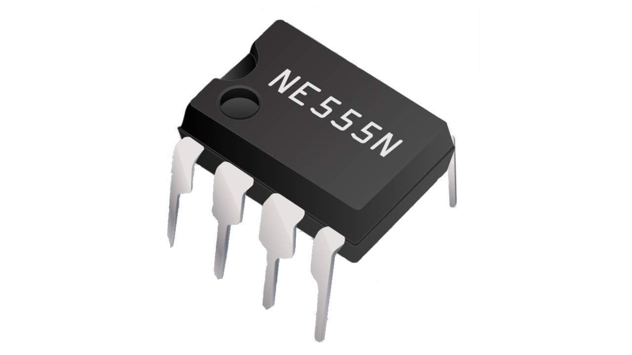
IC555 TIMER
The 555 timer IC is an integrated circuit (chip) used in a variety of timer, delay, pulse generation, and oscillator applications. Derivatives provide two (556) or four (558) timing circuits in one package.
The design was first marketed in 1972. Since then, numerous companies have made the original bipolar timers, as well as similar low-power CMOS timers.
In 2017, it was said that over a billion 555 timers are produced annually by some estimates, and that the design was "probably the most popular integrated circuit ever made"

Slide 10
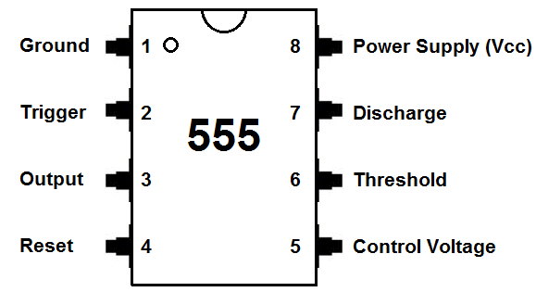
IC CIRCUIT DIAGRAM

Slide 11
PINS DESCRIPTION
GND Pin :Pin-1 is a ground pin which is used to supply a zero voltage to the IC.
Trigger Pin : Pin-2 is a trigger pin which is used to convert the FF from set to RST (reset). The output of the timer depends on the amplitude of the external trigger pulse that is applied to the trigger pin.
Output Pin :Pin-3 is an output pin.
Reset Pin :Pin-4 is a RST pin. When the negative pulse is applied to this pin to disable or reset, and false triggering can be neglected by connecting to VCC.
Control Voltage Pin :Pin-5 is the control voltage pin used to control the pulse width of the output waveform and also the levels of threshold and trigger. When an external voltage is applied to this pin , then the output waveform will be modulated
Threshold Pin :Pin-6 is the threshold pin, when the voltage is applied to threshold pin, then it contrasts with a reference voltage. The set state of the FF can be depends on the amplitude of this pin.
Discharge Pin :Pin-7 is the discharge pin, when the output of the open collector discharges a capacitor between the intervals, then it toggles the output from high to low.
Supply Terminal :Pin-8 is the voltage supply pin which is used to supply the voltage to the IC with respect to the ground terminal.

Slide 12

RESISTOR
A resistor is a passive two-terminal electrical component that implements electrical resistance as a circuit element. In electronic circuits, resistors are used to reduce current flow, adjust signal levels, to divide voltages, bias active elements, and terminate transmission lines, among other uses.
High-power resistors that can dissipate many watts of electrical power as heat may be used as part of motor controls, in power distribution systems, or as test loads for generators.
Fixed resistors have resistances that only change slightly with temperature, time or operating voltage. Variable resistors can be used to adjust circuit elements (such as a volume control or a lamp dimmer), or as sensing devices for heat, light, humidity, force, or chemical activity.

Slide 13
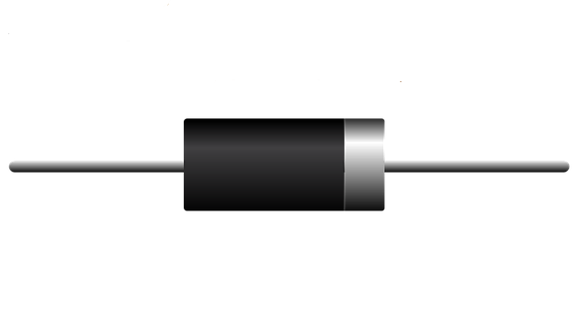
DIODE
A diode is a two-terminal electronic component that conducts current primarily in one direction (asymmetric conductance); it has low (ideally zero) resistance in one direction, and high (ideally infinite) resistance in the other.
A diode vacuum tube or thermionic diode is a vacuum tube with two electrodes, a heated cathode and a plate, in which electrons can flow in only one direction, from cathode to plate.

Slide 14
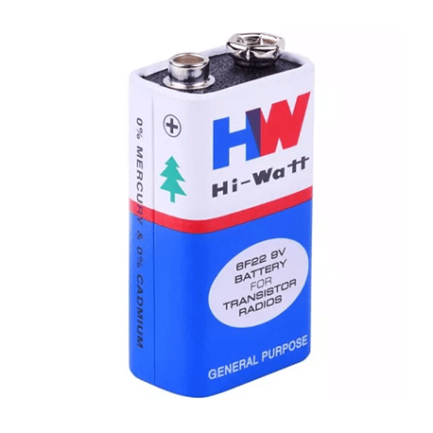
BATTERIES
An electric battery is a source of electric power consisting of one or more electrochemical cells with external connections for powering electrical devices.
When a battery is supplying power, its positive terminal is the cathode and its negative terminal is the anode.
The terminal marked negative is the source of electrons that will flow through an external electric circuit to the positive terminal.

Slide 15
Circuit diagram

Slide 16
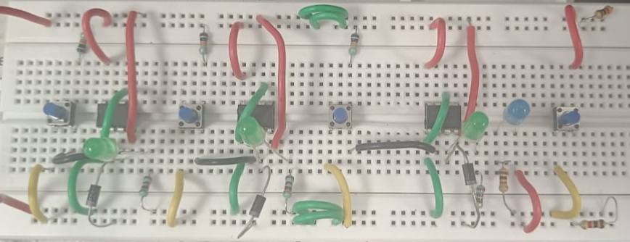
CIRCUIT DIAGRAM

Slide 17
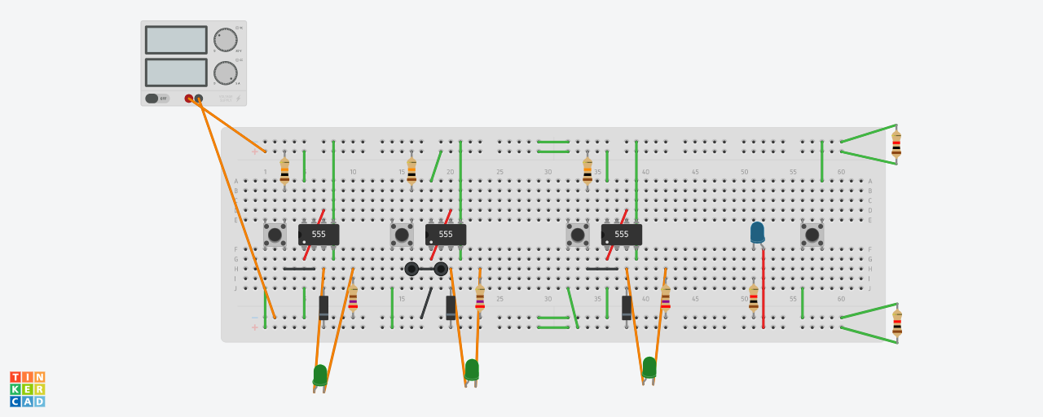
CIRCUIT DIAGRAM

Slide 18
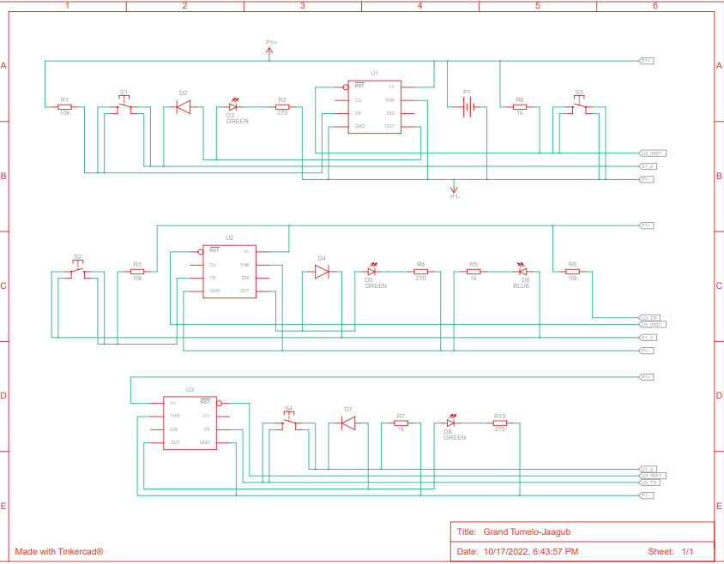
SCHEMATIC VIEW

Slide 19
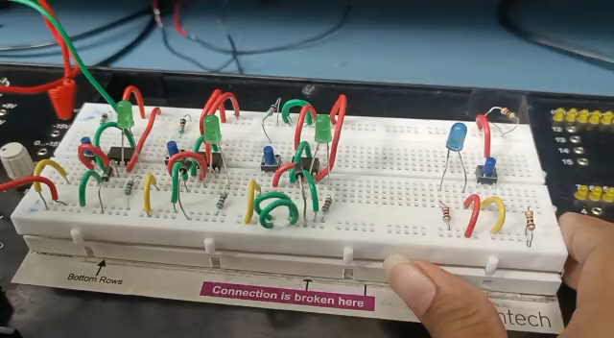
Video

Slide 20
working

Slide 21
WORKING
We are making the setup for three teams only as it is a demo but you can add up as many setups as you want. There is an LED for each team that glows when the button is pressed. Once the LED of any team is turned on then no other team will be allowed to speak as the LED for other teams will not glow if they push the button later.
There is a status LED that indicates that someone has pressed the button or the LED of someone’s team is on. We can also reset all the LEDs by pressing the reset button

Slide 22
Working Principle
Fastest finger first indicators (FFFIs) are used to test the player’s reaction time. The LED of the respective player’s will glow, when the player presses his entry button. The circuit presented here determines as to which contestant first pressed the button and locks out the other contestant.
If Pin-2 of 555 IC sees any voltage less than 1/3rds of the supply voltage, it turns the output ON. If the reset Pin of 555 IC sees 0V, it resets the output. Apart from positive and negative rails, we used two other rails.
Reset rail which is pulled up to positive voltage by default using a 1K resistor Status / Feedback rail which is pulled down to 0V by default using a 1K resistor. This rail is connected to output of all the modules via diodes. So this rail will be at 0V by default. But as soon as any of the modules output is ON, the voltage at this rail reaches positive voltage via the diode

Slide 23
So when the output of all the modules are in OFF state, the voltage at status rail will be at 0V (default). When any team presses the button, this 0V from status rail is applied at Pin-2. Because 0V is less than 1/3rds of the supply voltage, the output of 555 IC corresponding to the team which pressed the trigger first turns ON.
Immediately after this happens, the voltage at status rail changes to positive voltage because of the feedback via PN diode. So even if other teams press the trigger now, the voltage at Pin-2 of the respective modules will be at positive voltage and the output doesn’t turn ON. Resetting of states of all the modules is done by applying 0V at the reset pin of all the 555 ICs using reset rail and a dedicated push button.

Slide 24
Advantage

Slide 25
ADVANTAGES
Fastest response
Highly Sensitive
Low cost and reliable circuit

Slide 26
Applications

Slide 27
APPLICATIONS
This project is an electronic quiz circuit that is affordable.
This project is useful for a 3-team quiz contest, although it can be modified for more number of teams. This system is sensitive.
The circuit can record the first hit contestant among all the contestants that may appear to be simultaneous by naked eye.

Slide 28
resources

Slide 29
RESOURCES
https://rees52.com/ic-based/924-make-a-fastest-finger-firstgame-using-555-timer-ic-rs032l
https://elonics.org/fastest-finger-first-quiz-buzzer-circuit-using555ic

Slide 30


